Slide 1


CS1 Game Engine
bit.ly/cs1-education

Slide 2



Hello!
My name is Eric Eisaman
I am an enthusiastic educator from Auburn, Maine

Slide 3
CS1 is a research based curricular framework for designing lessons and units which can be flexibly integrated into any course.

Slide 4
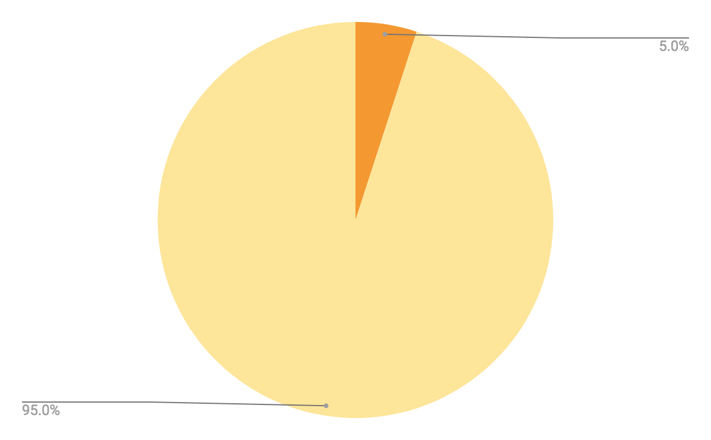
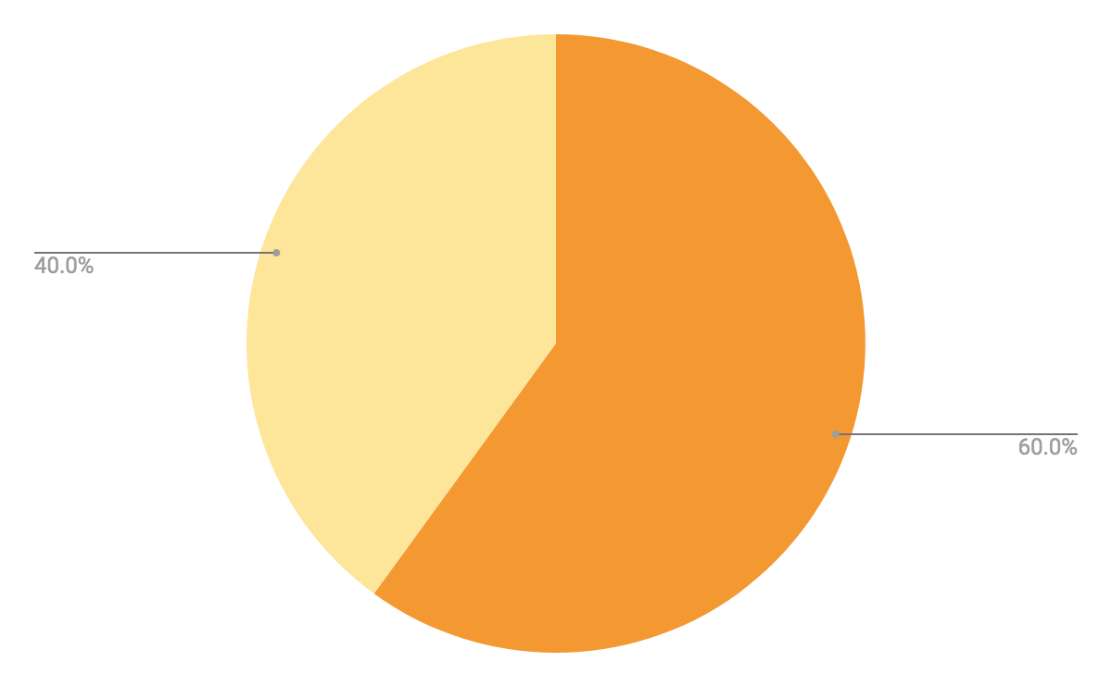
Student Survey Data
Identify as a Computer Programmer
Pre-test
Identify as a Computer Programmer
Post-test
YES
NO
YES
NO

Slide 5
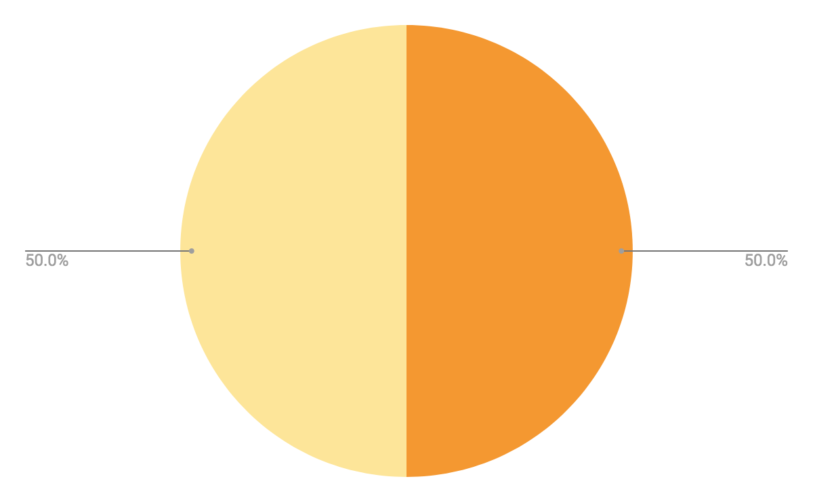
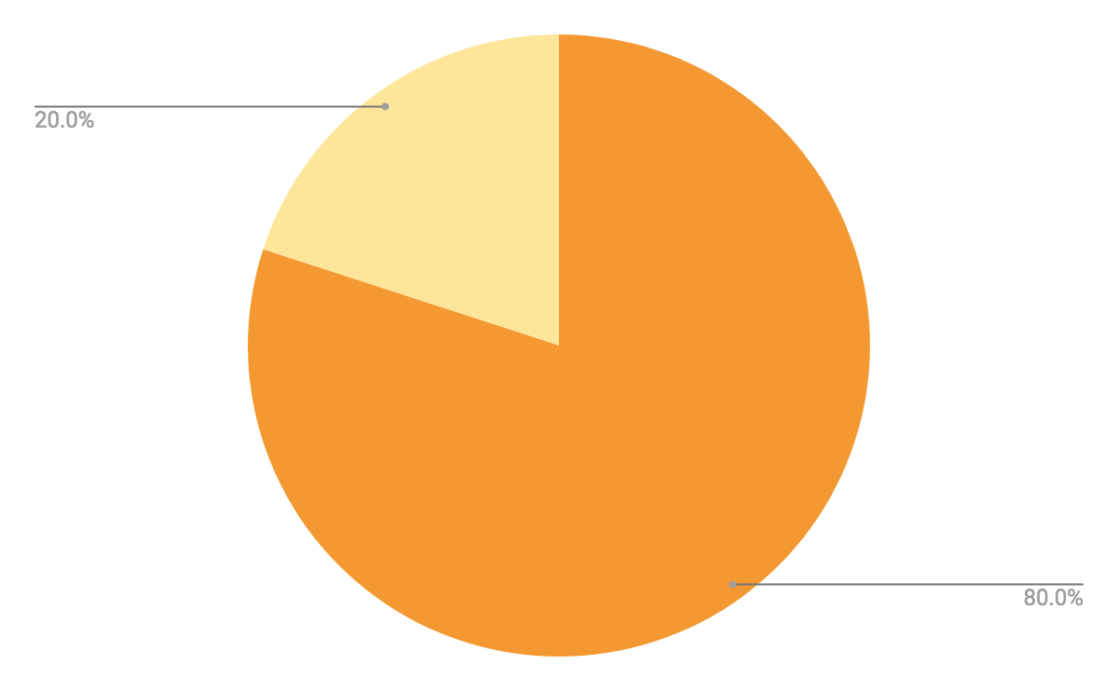
Student Survey Data
Consider a Career Requiring Computer Programming
Pre-test
Consider a Career Requiring Computer Programming
Post-test
NO
NO
YES
YES

Slide 6
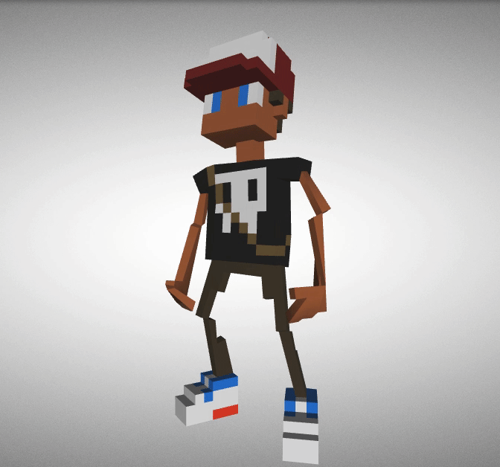
CS1 supports project and experience based learning.

Slide 7
CS1 Framework components
CS1 Game Engine
Is a 3D VR multiplayer game engine built with web technologies that serves as a basis for projects and learning experiences.
CS1 IDE
Is an integrated development environment providing structure and guidance in designing CS1 projects.
CS1 Curricular Templates
Provide for the quick and efficient design of custom lessons and units.

Slide 8

CS1 Admin
The CS1 Admin app is an installable PWA enabling management of user accounts and real-time gameplay moderation.

Slide 9
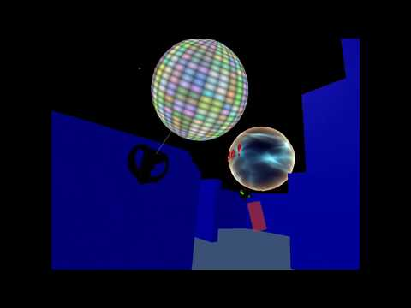
CS1 VR Experience
CS1 helps students build proficiency and self-efficacy through engaging projects and experiences which excite their curiosity and creativity. Entry level lessons and tutorials provide the structure and guidance for students and teachers to design, develop and explore their own custom 3D multiplayer VR applications.

Slide 10
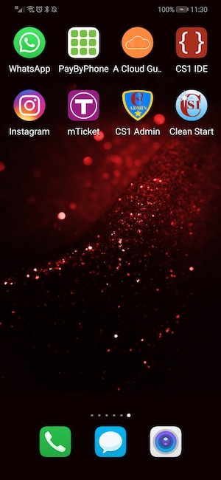
CS1 Applications on Phone
CS1 applications can be installed on phones. There is hardly a more powerful incentive than empowering students to create their own applications.

Slide 11
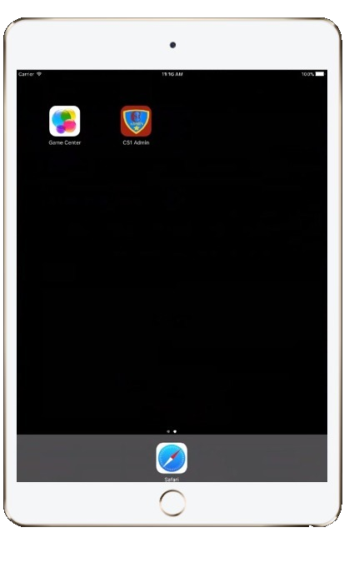
CS1 Applications on Ipad
CS1 applications can be installed on Ipads. All CS1 Applications work well with touch interfaces.

Slide 12

CS1 Applications on PC
CS1 applications can be installed on laptops and desktops where their launch icons can be added to the taskbar.

Slide 13

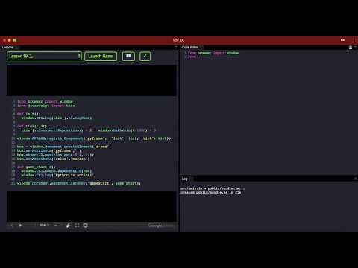
CS1 Python Support
The CS1 Game Engine and CS1 IDE support Python language programming.

Slide 14
Use Case Examples
Language Arts
Students write a story which is narrated by a voice within a custom designed 3D application environment.
Foreign Language
Students learn language and culture in an idyllic French town by purchasing items on a grocery list within 3D VR experience.
Math
Students create a mathematical model controlling the motion of an object within a custom 3D application environment.
Engineering
Students design IoT circuits and networks which integrate with a custom 3D multiplayer environment.
Computer Science
Students learn the fundamentals of computer science and programming while developing a custom 3D multiplayer game.
Physical Education
Students use an Oculus Quest VR system to get exercise in a custom VR experience.

Slide 15
Related Research
Deutsch, M. (2017),The Effect of Project-Based Learning on Student Self-Efficacy in a Developmental Mathematics Course
Shin, Myeong-Hee. (2018), Effects of project-based learning on students’ motivation and self-efficacy. English Teaching, 73(1), 95-114.
Prater M.L.,(2016),Student Authored Digital Games as Authentic Learning: Using the Can You Create a Game Challenge in Elementary Classrooms
Keenhold B.W., (2019),Assessing Quantitative Reasoning in a Ninth Grade Science Class Using Interdisciplinary Data Story Assignments
Lingard R., Barkataki S., (2011),Teaching Teamwork in Engineering and Computer Science

Slide 16

CS1 Game Engine Getting Started

Slide 17

CS1 Discord Channel

Slide 18

CS1 Slack Channel

Slide 19

CS1 Twitter

Slide 20

CS1 Facebook

Slide 21

CS1 Instagram

Slide 22
CS1 Website

Slide 23



Official GitHub Repositories

Slide 24
Starter Flow
bit.ly/cs1-remix
bit.ly/cs1-clean-remix
cs1-ide.glitch.me
cs1-admin.glitch.me

Slide 25
Advanced Flow
bit.ly/cs1-remix
bit.ly/cs1-clean-remix
bit.ly/cs1-ide-remix
bit.ly/cs1-admin-remix

Slide 26
CS1 IDE Templates
bit.ly/lessons-templates
bit.ly/quizzes-templates

Slide 27


3D Modeling Workflow
MagicaVoxel
Blender
.obj
.glb

Slide 28



Avatar Creation Workflow

Slide 29
Thanks!
Any questions?
You can find me at eeisaman@auburnschl.edu

